Slide 1
Covid Health Equity Technical Assistance
Quarterly Financial Report
March 2023
Notes:
Good morning, everyone. My name is Rose, and today, I’ll be showing you how to complete the Quarterly Financial Report for contracts funded by The Maine CDC Office of Population Health Equity. Let’s get started!

Slide 2
Agenda
Reporting Requirements
Quarterly Financial Report
Technical Assistance and Support
Notes:
For our agenda today, you’ll be learning about some basic reporting requirements, all about how to complete and submit the Quarterly Financial Report, and then I’ll give you some resources for technical assistance and support.

Slide 3
Reporting Requirements
Report on OPHE-funded activities, detailing activities, outputs, revenue, and/or expenditures for the performance period
Ensure compliance with state and federal requirements.
Identify opportunities for OPHE to support providers who may need more resources and technical assistance
Quarterly Progress Report
Quarterly Financial Report (QFR)
Agreement Closeout Report
Notes:
Reporting on activities and expenditures is a requirement for most grants, and OPHE grants are no different. The key reporting requirements for OPHE and Maine DHHS include the Quarterly Financial Report, the Agreement Closeout Report (which is due after your contract has ended), and the Quarterly Progress Report. Today we’ll be focusing on the Quarterly Financial Report (also known as the QFR) and this report is applicable to any cost-shared contracts with monthly prospective payments. While submitting these reports timely and correctly is important for maintaining compliance with the State of Maine and federal funding requirements, they’re also key opportunities for you and OPHE to identify where you and your organizations may benefit from more resources and technical assistance.

Slide 4
Quarterly Financial Report (QFR) 101
QFRs show your total revenue and expenses accrued from the start of your contract through that quarter.
DHHS utilizes the “cost settled” payments method which decreases reporting requirements and issues regular monthly payments. After the quarter ends, DHHS adjusts the next monthly payment as needed.
To complete your QFR, you need to have your reviewed contract budget, agreement and all of your expenses through that quarter.
Notes:
Your QFR is a financial report that shows your total revenue and expenses accrued from the start of your contract to the end of that reporting quarter that just concluded, and this is what DHHS uses to make sure that you receive correct payments based on your expenditures. DHHS uses the “cost settled” method for payments, which decreases reporting requirements and allows for regular monthly payments, and after each quarter ends, and you’ve submitted your QFR, DHHS adjusts your next payment based on whether expenditures were higher or lower than the regular monthly payment. There is no need for you to submit invoices or verification of actual expenses, but you do need to track them for your financial reporting, and you do need to retain receipts and verification of expenses for your records and in case you need them for audit purposes. You will also need your reviewed contract budget to complete your QFR.

Slide 5
QFR Header Section
Your agency name (located on your Budget Rider F-1 Pro Forma)
Your program name
Component Start
Component End
Start of first reporting quarter
End of last reporting quarter
DHHS Agreement # (located on your Budget Rider F-1 Pro Forma)
Advantage Contract # (located on your Service Contract)
For more details on this section, review the Quarterly Financial Report Instructions for Cost-Settled Contracts on the DHHS Contract Documents website.
Notes:
The first part of your QFR you’ll need to complete is the header section, and this contains some very basic information from your budget and your contract. You’ll put your agency and program name and component start and end date which is located on your Budget Rider F-1 Pro Forma. The reporting period would be from the start of your contract, the date of the first reporting quarter, and then the end date would be the last day of the reporting quarter. So if my contract started October 1, and I was reporting after Quarter 2, my reporting start date would be October 1, and my reporting end date would be March 31st (the last day of the second quarter). Next, you’ll grab your agreement number from your F-1 Pro Forma, which is labeled DHHS agreement number, and then you have your contract number, which is your Advantage Contract number and you can find this on your encumbered Service Contract.

Slide 6
Revenue, Expenses, and Adjustments on the QFR
Accrual Year to Date should include the following revenue and expenditures each quarter:
Q1 QFR: Q1 expenditures
Q2 QFR: Q1 + Q2 expenditures
Q3: Q1 + Q2 + Q3 expenditures
Q4: Q1 + Q2 + Q3 + Q4 expenditures
Q5: Q1 + Q2 + Q3 + Q4 + Q5 expenditures
Agreement Budget | Accrual Year to Date | Expenses as % of Budget
Enter amounts from your approved budget into the (for each line item). | Total revenue or expenditures for each line item (accumulated since the start of the contract) | Will automatically calculate
IMPORTANT: Do not enter information into or change any yellow cells! This will cause calculation errors.
Notes:
So now let’s get into how we really complete the bulk of this report. There are three columns on this report, and you only need to enter information into the first two, which is the agreement budget column and the accrual year to date column, as the expenses as a percent of budget column is formula based. For the agreement budget, all you need to do is copy and paste the amounts from your latest fully reviewed budget into each appropriate line. You can look for your most recent email from the Contract Budget email, contract-budgets.dhhs@maine.gov. Also the QFR actually says which line you’d be pulling from, so it’s very cut and dry. In the second column, Accrual Year to Date, this is where you enter the total revenue or expenditures for each line item and this would be the total accumulated amount from the start of the contract through the end of the reporting period. As I started to get into before, as you reach each new quarter, accrual year to date column will include the total from the current quarter, PLUS any previous quarters. So once you complete quarter two, you’re reporting the total of not just quarter 2 numbers, but Quarter 2 PLUS the previous quarter. Quarter 3 includes Quarter three, plus Quarters 1 and 2, and so on.
For the third column which are expenses as a percent of budget, these cells will automatically calculate as well as any other yellow-shaded cells. (Click) Please don’t enter any information into those yellow cells because you’ll remove the formula and most likely end up with some calculation errors.

Slide 7
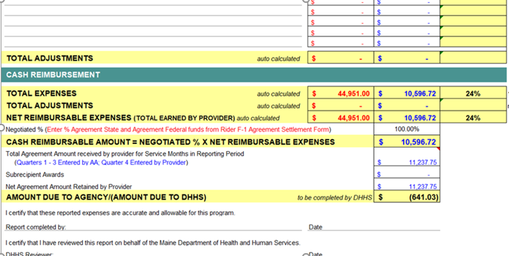
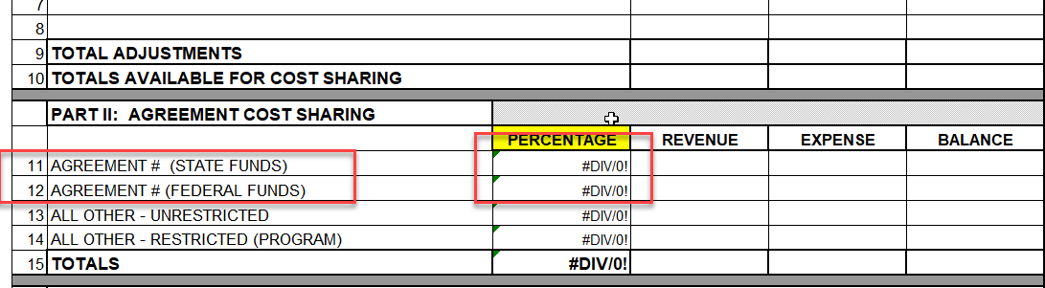
Amount Due to Agency/DHHS – Cash Reimbursement Section
Most of this section will be auto-calculated or completed by DHHS.
On line 137, enter your negotiated percent from your Rider F-1 ASF from your budget. This is the sum of the two percentages on lines 11 and 12.
1
1
Rider F-1 ASF tab of your budget
Notes:
So after you’ve completed all of your revenues, expenditures, and applicable adjustments you’ll get down to the bottom of the report, which is the Cash Reimbursement Section, and this is where your DHHS will determine if your next payment will need to be adjusted. Most of this section will be automatically calculated or completed by DHHS, but there are a couple areas you want to be on the lookout for. (CLICK) On line 137, you’ll enter your negotiated percent from the Rider F-1 Agreement Settlement Form tab (ASF), CLICK, which is this screenshot right here), and you’ll simply enter the sum of the percentages on lines 11 and 12 from this tab of your budget.

Slide 8
Amount Due to Agency/DHHS – Cash Reimbursement Section
Total Agreement Amount Received (Line 139) is ONLY for DHHS use, unless it is the final QFR of the contract or contract year (for multi-year contracts).
2
2
Amount Due to Agency (Line 142) is the amount that your next payment may be adjusted by. If the amount due is greater than $1000 – either your next payment may be increased if you were underpaid or decreased if you were overpaid. This is completed by DHHS.
3
3
4
4
Type your name and date.
Notes:
So now we’ll move just a bit further down this closing section of the report. For line 139 (CLICK) which is your total agreement amount received for the service months in the reporting period, this will be completed by the Budget Team, unless it is the final QFR of the contract or contract year (for multi-year contracts). (CLICK) For Amount Due to Agency/Amount due to DHHS, on line 142, this cell will automatically calculate whether there is amount due either to you or DHHS that should be reflected in your next payment. If it’s an amount below $1000, no adjustment will be made, but if the amount is over $1000, then your next monthly payment would be adjusted to reflect that amount, and then your next payments will just be your regular monthly payment amount, which is your total agreement divided by the months of your contract.
(CLICK) Lastly, please type your name and date into the Excel file before submitting it. You don’t need to print it and sign and scan it, but just make sure you don’t forget to type your name and date into here.

Slide 9
Quarterly Financial Report Submission
Where is it? | How to Submit | When to Submit
Maine DHHS Contract Documents | Send via email to: contract-budgets.DHHS@maine.gov and CDC-OPHE-Support@maine.gov | Due on the 30th day of the month following end of the quarter.
Q1: Oct - Dec → Due Jan 30th
Q2: Jan - March → Due April 30th
Q3: April - June → Due July 30th
Q4: July - Sept → Due Oct 30th
Important: Failure to submit program and financial reporting timely may result in payment delays to providers or contract termination.
Notes:
Now, once you’ve completed your QFR, it’s time to submit it. You’ll simply email the Excel file to the budget team at contracts-budgets.dhhs@maine.gov and CDC-OPHE-Support@maine.gov. The QFRs are always due on the 30th day following the end of the quarter, so January 30th, April 30th, July 30th, and October 30^{th.} Please remember these dates, add them to your calendars, and maybe put an advance alert 1-2 weeks before it’s due so you can start working on them and give yourself enough time to ask questions and seek some support if needed. If you think that you won’t be able to submit it on time, please email OPHE to request an extension. Submitting program and financial reporting on time is a requirement of your OPHE contracts, and not getting those in can result in payment delays or contract termination, so make sure you give yourself enough time to complete these reports and ask for help if needed.

Slide 10
QFR Submission and Review Steps
1
2
3
4
Certify that all reported expenses are accurate and allowable for the applicable program by typing your name and date.
Email QFR Excel file to:
Contract-Budgets.DHHS
@maine.gov
and
CDC-OPHE-Support@maine.gov.
Do not submit via the Grantee Portal.
The Budget Team reviews, signs and returns the QFR to you as accepted, or requests corrections if needed.
Your Grantee Portal Dashboard will update to show that
your QFR has been received, if it needs corrections, or if it is overdue. Check it often!
Notes:
So here’s a brief review of the QFR Submission and Review Steps.
(CLICK) Before sending the QFR excel file, make sure you certify that the reported expenses are accurate and allowable by typing your name and date. (CLICK) Next, email the QFR excel file to the budget team and OPHE support email. Do not submit it via the Grantee Portal as that is currently only for progress or performance reports. (CLICK) Next, the budget team will review your QFR, and if it’s good to go, they’ll sign it and return it to you as accepted, or they email you asking for some corrections. Make sure you make those corrections and respond timely. (CLICK) Lastly, even though you won’t submit the QFRs in the portal, your Grantee Portal Dashboard will update to show that your QFR has been received or if it needs corrections. It will also show you if it’s overdue, so make sure you check it often. It might take a few days to update with the current status, but it will be updated regularly.

Slide 11
Quarterly Financial Report Tips
Refer to your Budget Form Rider-F and contract agreement.
Review the QFR instructions on the Maine DHHS Contract Documents website.
If the Budget team notifies you that corrections are needed, please submit them timely.
Conduct regular monthly bank reconciliations to track your revenue and expenses each month.
Want to learn more about bank reconciliations? Watch the webinar on ophepartners.org!
Notes:
: So as we wrap up talking about how to complete the QFR, here are just some reminders and tips. Refer often to your Budget Form Rider F and your contract agreement. Each line tells you where to pull this information from on your most up to date budget. Also, if you ever need to amend your budget and you’re doing your next QFR, make sure you are using that most recently amended budget. Next, be sure to review the QFR instructions which are on the Maine DHHS Contract Documents page. The instructions are very detailed and can help clear up a lot of confusion when you’re working on this for the first time. Next, if the Budget team notifies you that you need to make some corrections to your QFR, please make those corrections timely and reach out for help if needed. And lastly, your organization should be conducting monthly bank reconciliations which is simply reconciling your revenue and expenses to what’s going on in your general ledger, and we have a recorded webinar and resources all about bank reconciliations on the OPHE Partners website, so be sure to check that webinar out if you want to learn more.

Slide 12
Technical Assistance and Support
Reach out for technical assistance and support via email at CDC-OPHE-Support@maine.gov or directly to the Contract Budget Team at Contract-Budgets.DHHS@maine.gov
You can also submit a TA request on the OPHE partners website! www.ophepartners.org
Live informational webinars
Individual TA sessions by request
Dedicated TA mailbox
Maine DHHS Contract Documents webpage – Reports and Instructions
Maine OPHE Partners Website & Grantee Portal: Array of resources including forms, instructions, tips, and recorded webinars and materials.
OPHE Provider Handbook (Coming soon!)
Notes:
Well that sums up how to complete the Quarterly Financial Report. If you have any issues or questions, OPHE is ready to provide technical assistance and support. Live informational webinars are conducted regularly, you can request an individual TA session, or submit your questions to a dedicated TA mailbox, CDC-OPHE-Support@maine.gov, or directly to the budget team at contract-budgets.dhhs@maine.gov. You can also submit a TA request at ophepartners.org which has a slew of resources, forms, instructions, tips, and recorded webinars and materials. Another resource is the OPHE provider handbook which has a lot of information about the contract process, payments, reporting and more, and that will be distributed to OPHE grantees in the coming weeks.

Slide 13
Notes:
Thank you very much for joining us today, and we look forward to supporting you with resources and information as you carry out your OPHE contract work. Have a great day.

