Slide 1
Covid Health Equity Technical Assistance
OPHE Grantee Portal and Dashboard
February 2023
Notes:
Good morning everyone. My name is Rose, and today, I’ll be showing you OPHE’s Grantee Portal and Dashboard for Health Equity, Vaccine Equity, and Social Support Initiatives. Let’s get started.

Slide 2
What You’ll Learn About
The OPHE Grantee Portal
Logging In
Portal Features
TA
Contracts
Payments
Reports
Report Submission
Notes:
For our agenda today, I’ll be introducing you to your grantee portal, showing you where to log in, the portal’s features, and how you can submit your performance reports.

Slide 3
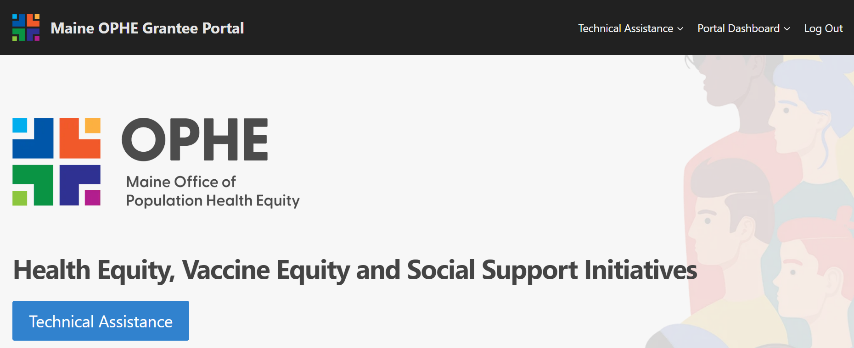
OPHE Grantee Portal: OPHEPartners.org
OPHEPartners.org
Your one-stop shop for:
Technical Assistance
Contract status
Payment history
Reporting alerts and submissions
Notes:
The OPHE grantee portal is a website dedicated to grantees receiving funding from the Maine Office of Population Health Equity, and it’s your one-stop shop for technical assistance and resources, status updates about your contract, your project’s payment history, and for report alerts and submissions. Now let’s dive in.

Slide 4
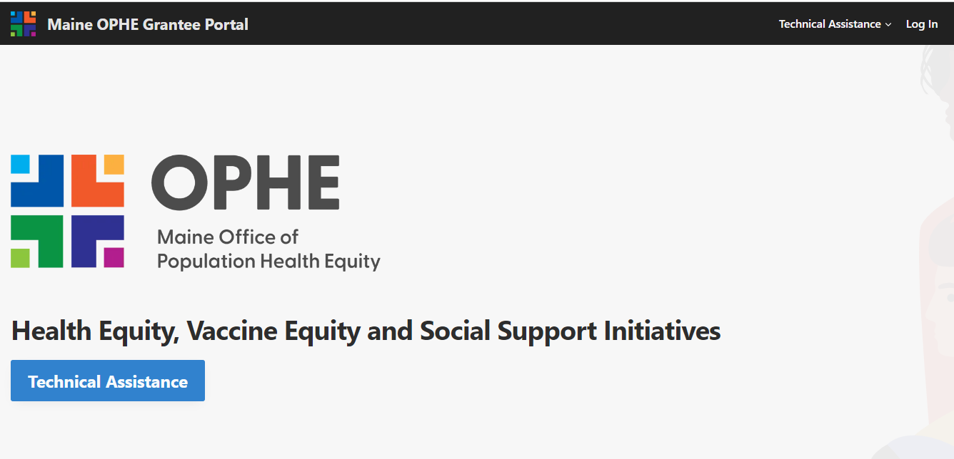
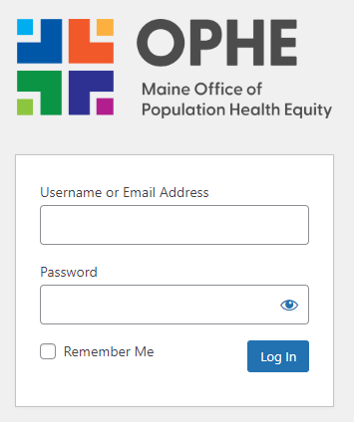
Portal Home Page
Log in at the top right corner of the portal home page.
If you need log in credentials, create a Technical Assistance Request or email CDC-OPHE-Support@maine.gov.
Check out technical assistance resources and recorded webinars.
Visit OPHE’s website.
Notes:
So here is the main page of the grantee portal at ophepartners.org. You can click on this blue button, or in the top right for technical assistance. There are great resources in there about completing reports, finances, and other topics such as to help you build organization’s reach and capacity. It also includes any recorded webinars, trainings, and key documents and forms.
You can also visit the OPHE website by clicking “Visit Website” down here in the bottom right corner.
Now, to get logged in…Click on “Log In” at the top right corner of the portal home page. This will take you to the log in page where you’ll enter your log in information. This should have already been provided to you, but if you haven’t received your log in credentials, you can create a technical assistance request by going to the Technical Assistance or TA home page, and you can also simply email the OPHE support email.

Slide 5
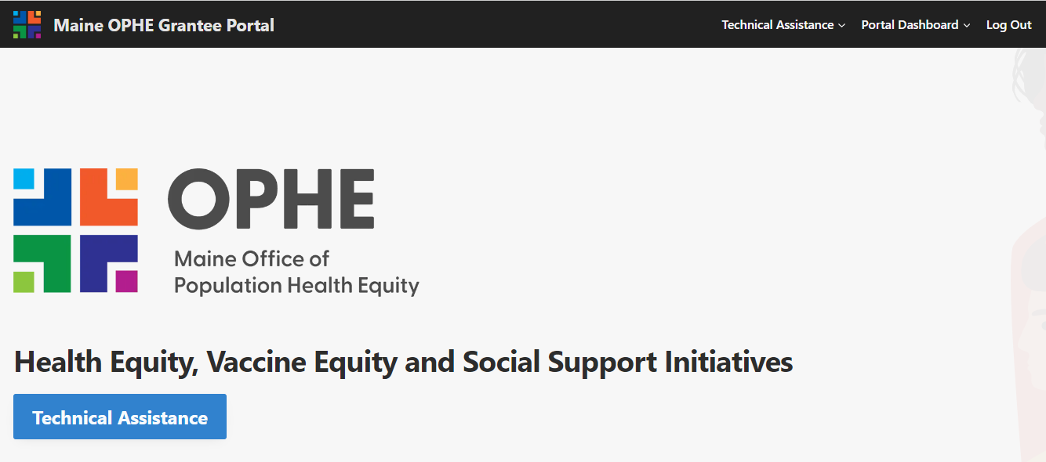
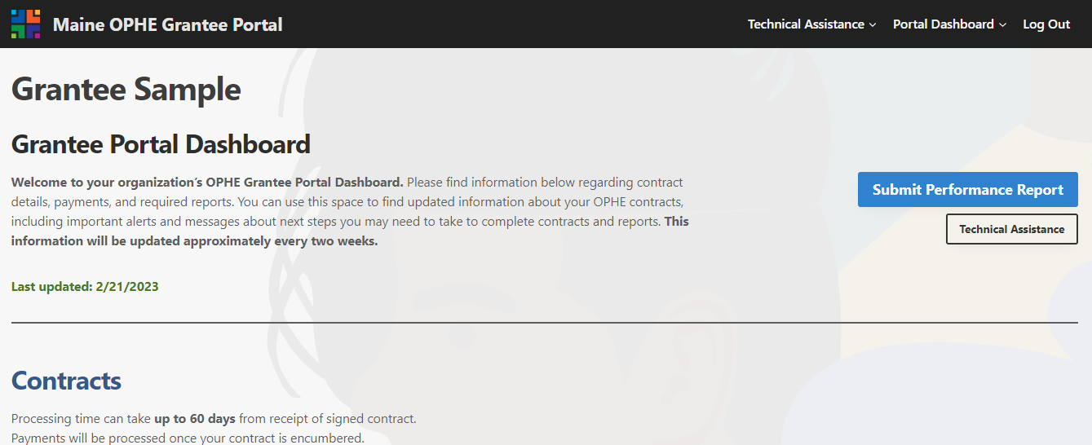
Accessing the Grantee Portal Dashboard
1
After logging in, click on Portal Dashboard in the top right of your screen.
2
3
You are now in your Portal Dashboard!
Click Submit Performance Report to upload reports and other documents.
4
Click Technical Assistance for the TA page.
5
Scroll down to access your contract, payments, and report information and alerts.
Notes:
So now that you’re all logged in, let’s take a look at accessing the Grantee Portal Dashboard. Once you’re logged in, Click on Portal Dashboard in the top right portal of your screen. You’re now in your individual portal dashboard. You can click on the blue button that says “Submit Performance Report to upload reports and other documents. Below that you can click the technical assistance to take you right to the TA page, and that link is also at the top right of the page next to portal dashboard. Lastly on this same page of your dashboard, you have access to all of your organization’s information for your OPHE contracts, payments, and report information, as well as your report upload window, and all you need to do is scroll down, so let’s do that!

Slide 6
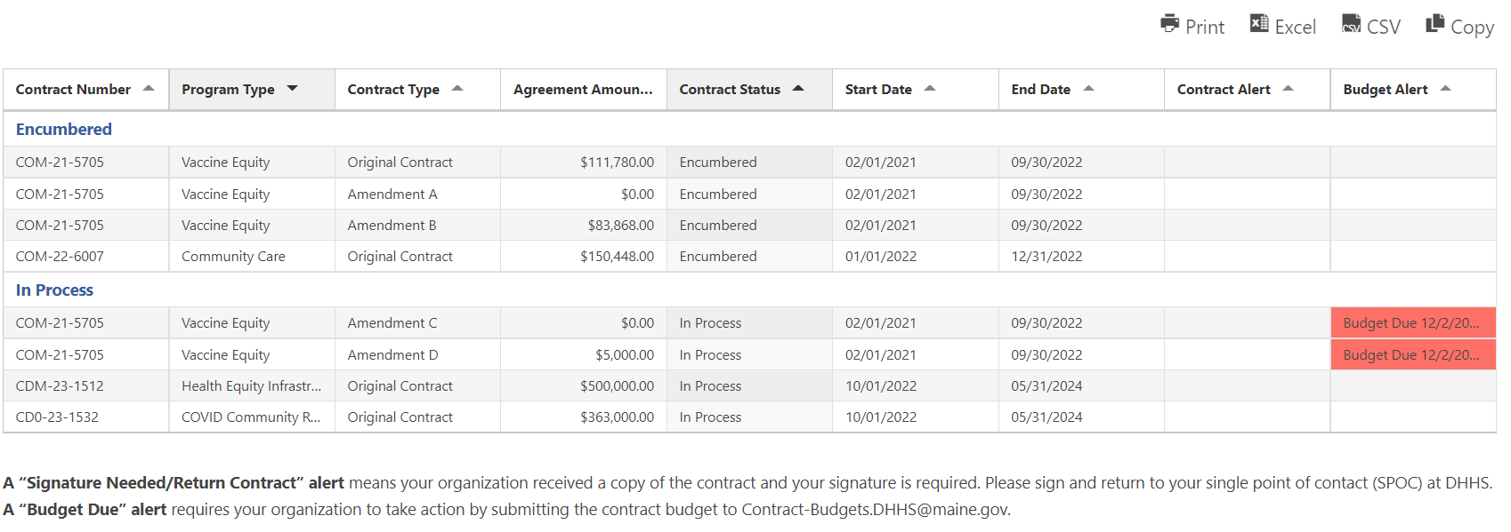
Contracts
Click the icons to print, copy, or generate an Excel or CSV file of the tables.
View all your OPHE contracts by number, program, type, amounts, status, dates, and key alerts.
Click on the section headers to sort by contract, amount, dates, alerts, etc.
Click on the alert cell to see more information about the alert.
Notes:
So this is what your contracts section in your dashboard looks like. Again, we got here just by scrolling down on your dashboard page, and you can view all of your OPHE contracts by number, program type, agreement amounts, your contract status, which is great to know if your contract is encumbered or in progress, and key alerts.
You can easily sort by any of these column headers by just clicking on the header in the top of the column that you want to sort by.
In this example, we see these two red cells down here and that shows you that you have an alert. To view the entire alert, click on the alert cell and a small window with the full information will pop up so you can see if there’s any action you need to take.
I also want to draw your attention to this fine print on the bottom which will be easier to read when you’re logged into your dashboard, but two of the key alerts you might see is “Signature Needed/Return Contract” alert or a “Budget Due” alert”. For the signature/return contract alert, that just means that your organization should have received a copy of your contract, and you need to sign it and return it to your single point of contact, or, SPOC at DHHS. The Budget Due alert just means that your organization needs to submit your contract budget to DHHS. So be on the lookout for any alerts in here.
Lastly, at the top right of the section, you can click on the icons to print or copy your report table, or generate an Excel or CSV file. Now, let’s scroll down to your Payments Section.

Slide 7
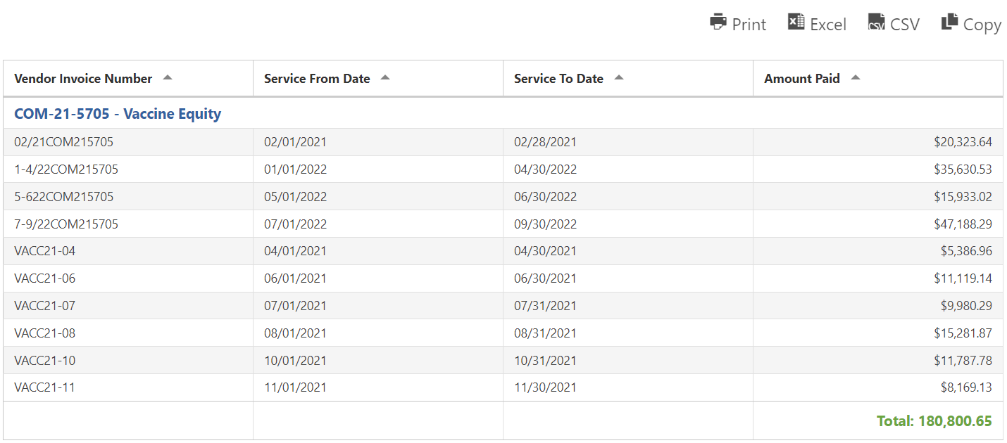
Payments
View your OPHE payments by vendor invoice number,, dates, and amounts.
Click on the section headers to sort by Vendor Invoice #, dates, and amount paid.
View your total payments received in the bottom right.
Notes:
So here we are in your payments section of your dashboard. It’s set up very similarly to your contracts section in a table format here. You can sort by vendor invoice number, service dates, and the amount paid. Also you can view your total payments received down here in the bottom right. And as with the previous section, you can generate this to an excel or csv file, and print and copy as needed.

Slide 8
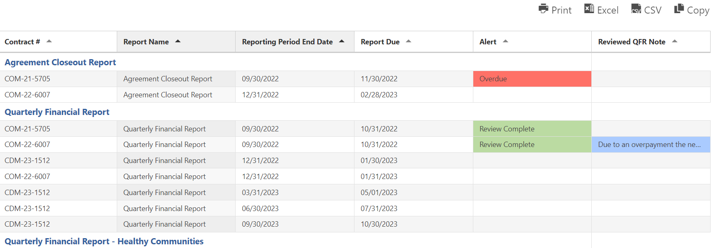
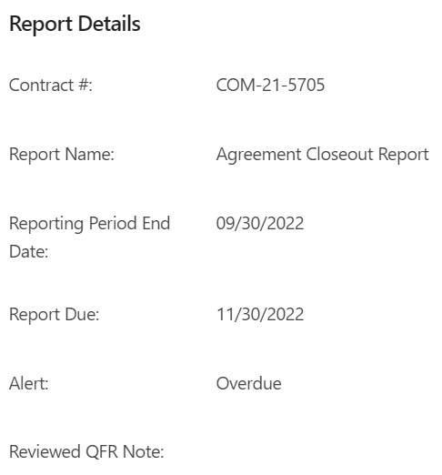
Reports
View your contract reports information by number, report name, dates, and key alerts.
Click on the section headers to sort by Contract #, Report Name, dates, alerts, and notes.
Click on the cells in the Alert and ‘Reviewed QFR Note to see more information about the alert.
Notes:
Now, let’s get into your reports section. All we did was scroll further down the page to get here, and in this table, you can view key alerts and due dates for each of your OPHE contracts. You can sort each column by clicking on the column headers to sort by your contract number, report name, reporting period end dates and due dates, and by alerts and Quarterly Financial Report (QFR) review notes. By clicking into the colored alert cells you, you can see more information about the alert for that particular report. If you have an overdue alert for a progress report or Quarterly Financial Report, that means that you need to get those submitted. If it’s a progress report, you’re going to submit it via the portal, which I’ll show you how to do next. If it’s a Quarterly Financial Report, you need to submit that to the contract budget team by emailing contract-budgets.DHHS@maine.gov. Once you click on an alert a box will open that contains more information about the report.

Slide 9
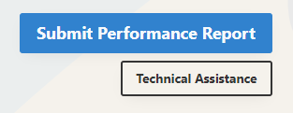
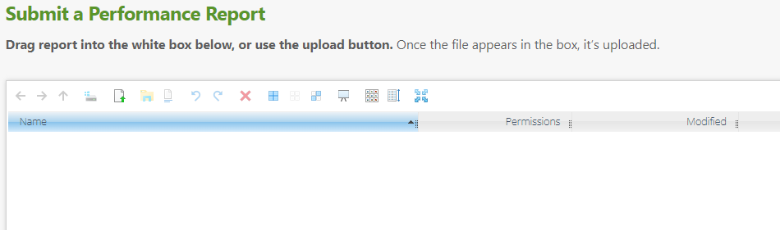
Submitting Performance Reports
Click on Submit Performance Report at the top of your dashboard.
OR
You can also scroll to the bottom of the dashboard page to the Submit a Performance Report section.
Drag your report file into this white area or use the upload button.
Notes:
So now let’s look at how to Submit a performance or progress report! All performance and progress reports are uploaded directly into the portal into this “Submit a Performance Report Section which has this white window. To get there, you can click on the blue button that says “Submit Performance Report” which is at the top of your dashboard once you log in, and this just shoots you down the page to the upload section. You can also simply scroll down to the bottom of your dashboard page, and this will get you there too. Click. To upload your report you can drag your report file into this white area, or you can use this upload button with the green arrow.

Slide 10
Submission Features
After a user has submitted a report, it will appear in the submission box. OPHE may also upload templates or other documents that you can download.
Note: If there are multiple users for your organization, a submitted report will only appear in the submission box for the user that uploaded it.
Click on a report to select it and click the Open icon to download a submitted report.
Click on a report to select it and click the X icon to delete it.
These icons can be selected to change how your reports look by changing colors, by icons, lists, or full screen.
Notes:
Now, let’s talk about some submission features. After a user has submitted a report, it will appear in the white submission box, and you can see an example of what that looks like down below where we can see that a progress report has been uploaded with the blue highlight. OPHE may also upload templates or other documents that you can download. Now, an important note about submitting reports. If your organization has multiple users and someone submits a report, it will only appear in the submission box in that one person’s dashboard. So make sure you know who is submitting your reports and communicate about report submissions so multiple users don’t submit the same report, or become concerned that the report is missing. If a report hasn’t been received, you’ll get an alert in your dashboard showing that it’s overdue.
Now for some more submission box features, CLICK you can download a document by clicking on that specific report to select it, and then click on this “Open” icon to download the report or document. To delete a report, click on a report to select it, and then click on this x icon to delete it. You can also change how your reports appear in the box by clicking on these different icons to change colors, show them as icons, by lists, or in a full screen.

Slide 11
Portal Pointers and Support
Once a document is uploaded or contract status changes, it may take up to two weeks to reflect the change. Keep an eye out for updates!
Remember that Quarterly Financial Reports (QFRs) must be emailed to contract-budgets.DHHS@maine.gov (not via the portal)!
Please follow the proper naming convention when submitting reports.
For help with the portal, submit a TA request on the OPHE partners website! Visit www.ophepartners.org.
You can also email CDC-OPHE-Support@maine.gov for help logging in or completing and submitting reports.
Notes:
So for some last portal pointers and support. Once a user uploads a document, or a contract status changes, or a payment goes out, it may take up to two weeks to reflect the change, so keep an eye out for updates. Next, remember that the quarterly financial reports (QFRs) must be emailed to contract-budgets.dhhs@maine.gov. They’re typically due at the same time as your progress reports, but just remember that QFRs don’t go into the portal! Next, please remember to follow the proper file naming convention when uploading reports. This will help OPHE find and organize your reports easier. The instructions for the naming convention are in everyone’s report templates.
If you need any help with the portal, you can submit a TA request directly on the website, which again, is opheparters.org, and you can also email the OPHE support email for help logging in to your dashboard, or completing and submitting reports.

Slide 12
Notes:
That sums up our introduction to the OPHE partners portal and dashboard. We hope that you find the resources helpful and that you feel more confident uploading reports. Thank you for joining me, and have a great day.

