Slide 1
Covid Health Equity Technical Assistance Canva Tutorial | August 4, 2022

Slide 2
Agenda
What is Canva?
Overview of Canva Functionality
Basic Graphic Design Principles
Tutorial

Slide 3
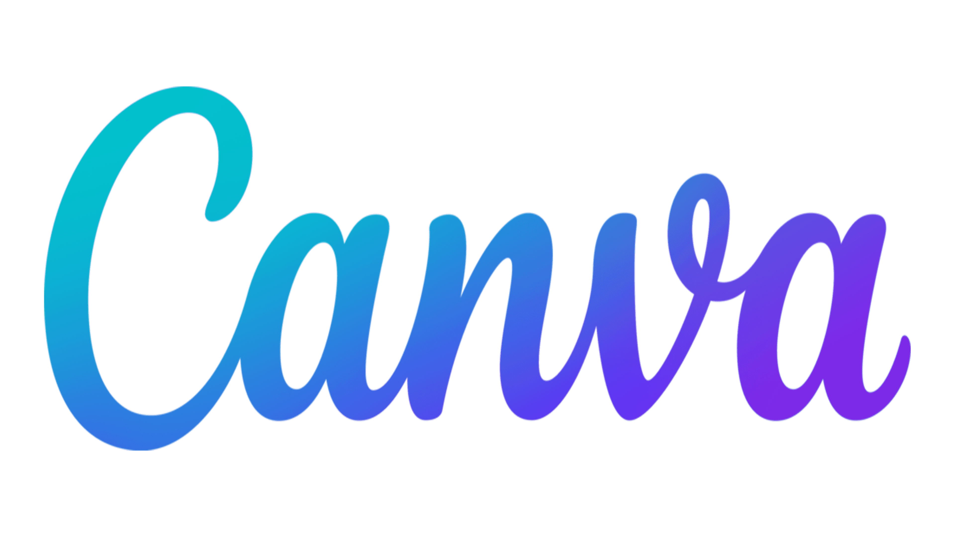
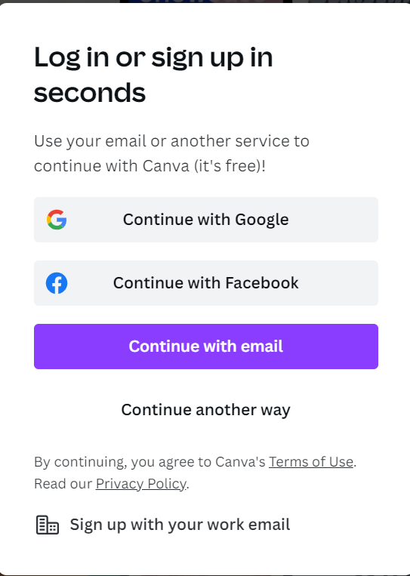
What is
?
Get started with Canva!
Create an account, using your email and creating a password
Canva is a web-based graphic design platform that can be used to create:
Social media posts
Posters
Flyers
And more!
Feel free to log on to Canva now and follow along throughout the session!

Slide 4
Templates
Click on the Templates icon at the sidebar to find editable designs for the type of material you’re creating
Search for themes and topics to help find the right template for your purposes
Edit and move features within the template to better fit your content
Upgrading to Canva Pro for a monthly fee gives you access to more templates and features!

Slide 5
Elements
Elements can be lines and shapes, graphics, stickers, photos, frames, and audio/video clips
Edit elements by dragging and dropping into position, resizing, or even changing their colors
Search for elements by keyword to find what you are looking for
Elements can help add visual interest and dimension to your design

Slide 6
Uploads
Use Uploads if you want to include your own graphics/content
Click the button “Upload Media” and you’ll be able to select content from your own computer
Uploads will remain in your library and saved for future use
You can upload photos, videos, and audio clips, in a variety of file types

Slide 7
Text
Click on the sidebar to add text boxes to page
Once added, you can edit the font (size, colors, highlights, etc.)
You can also drag to resize text boxes
Canva has suggestions for fonts that look good together and presets for sizing
When in doubt, use less text!

Slide 8
Basic Principles of Design
Color
Typography
Spacing

Slide 9
Color
2-3 colors in one design is a good rule of thumb
Use colors that complement each other
Choose colors that are either all warm tones or all cool tones to avoid clashing

Slide 10
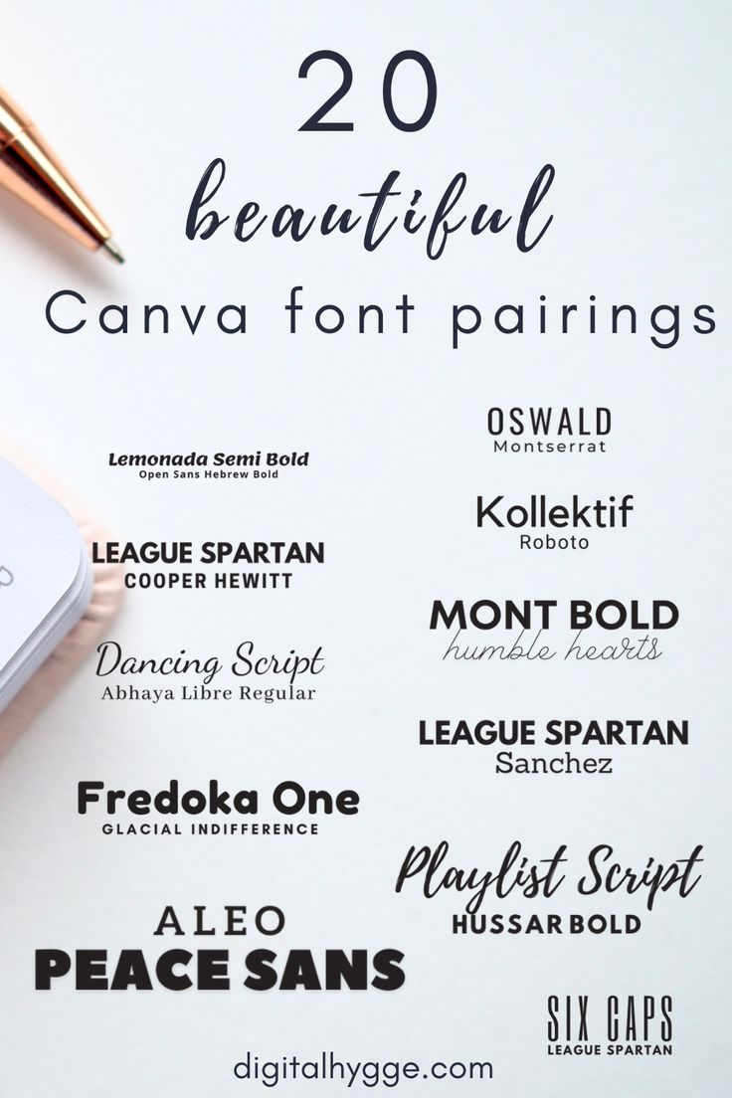
Typography
Use no more than 3 fonts
Develop a visual hierarchy (headers vs. body text)
Choose fonts that pair well together
Default to fonts that are legible and easy-to-read

Slide 11
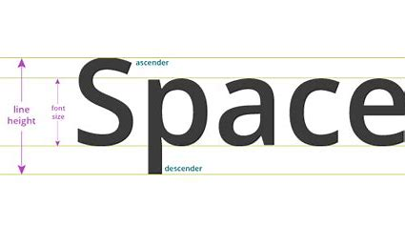
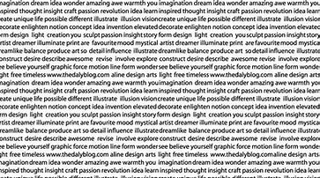
Spacing
Leave “white space” – large blocks of text are difficult to read
Create space between paragraphs
Pay attention to alignment
Gridlines and alignment guides automatically pop up on Canva to assist with proper spacing and alignment

Slide 12
Resources
Canva Resources
Graphic Design Resources
Learn – Articles and Resources | Canva Blog
Design School Tutorials | Canva.com
Help Center | Canva.com
8 Basic Design Principles to Help You Make Awesome Graphics | Adobe.com
10 Graphic Design Rules You Should Never Break | DBI (digitalbrandinginstitute.com)
Typography Rules in Graphic Design | ACIL
Don’t be overwhelmed! Find a program and style that works
best for you!

